Slide 1
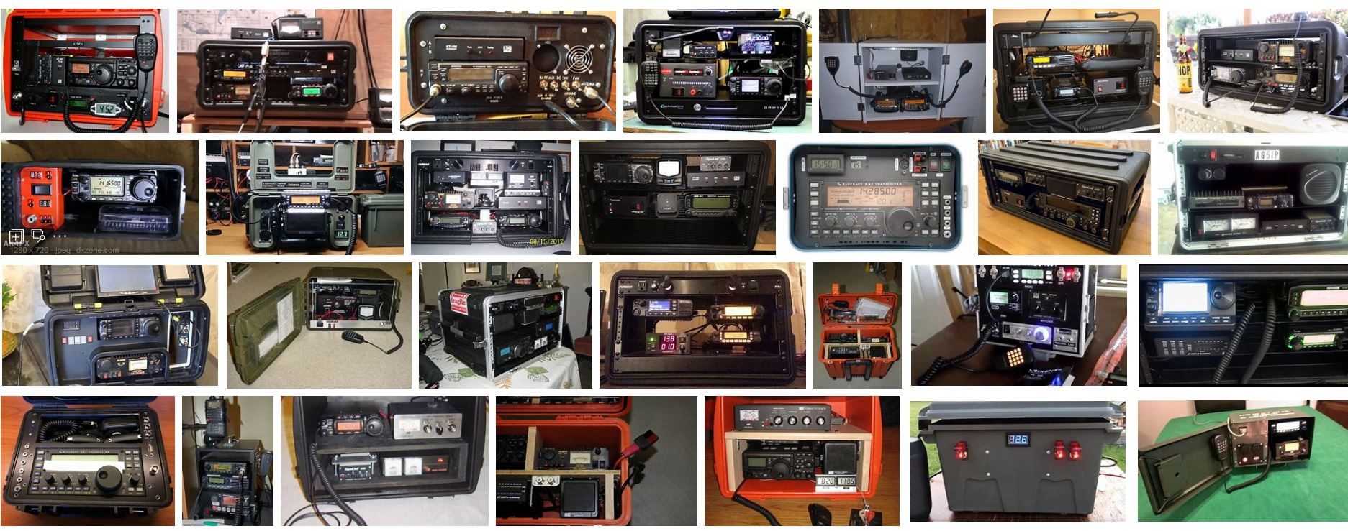
Radio Go Box Discussion

Slide 2
Radio Go Box Discussion Points
Some things to consider before starting
Battery, Component, Box and Tool considerations
Case study

Slide 3
Some Things to Consider Before Starting
$
May dictate what you do regardless of your desires
Using what you have instead of buying all new
Phase plan
Product Quality
Tools and Spares

Slide 4
Some Things to Consider Before Starting
$
What frequencies do you want to cover
Antenna considerations
Multiple boxes

Slide 5
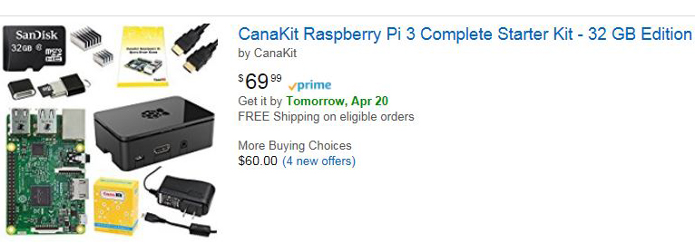
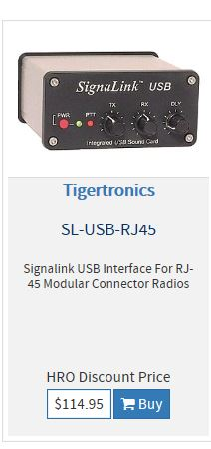
Some Things to Consider Before Starting
$
What frequencies do you want to cover
Include ability to send data?
Signalink TNC’s
Computer hardware
Computer software
Dedication of Transceiver

Slide 6
Some Things to Consider Before Starting
$
What frequencies do you want to cover
Include ability to send data?
How long may you have to transmit without AC power?
May depend on the “event” – one size fits all or multiple sizes?
Is this more for fun / show and tell one day events or for a true emergency?

Slide 7
Some Things to Consider Before Starting
$
What frequencies do you want to cover
Include ability to send data?
How long may you have to transmit without AC power?
How many other devices need connectivity and how many amps to they draw?
All DC or are some AC like a computer
Do all need to be “on” at the same time?
Also, what type of connections do they all require?
Will other operators require your help or your battery?

Slide 8
Some Things to Consider Before Starting
$
What frequencies do you want to cover
Include ability to send data?
How long may you have to transmit without AC power?
How many other devices need connectivity and how many amps to they draw?
What resources are available to recharge?
Generator
Solar

Slide 9
Some Things to Consider Before Starting
$
What frequencies do you want to cover
Include ability to send data?
How long may you have to transmit without AC power?
How many other devices need connectivity and how many amps to they draw?
What resources are available to recharge?
What is the operating environment?
Heat and Moisture
Transportation and size of working area

Slide 10
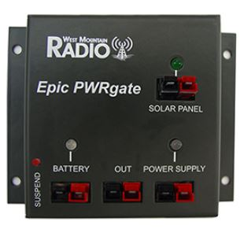
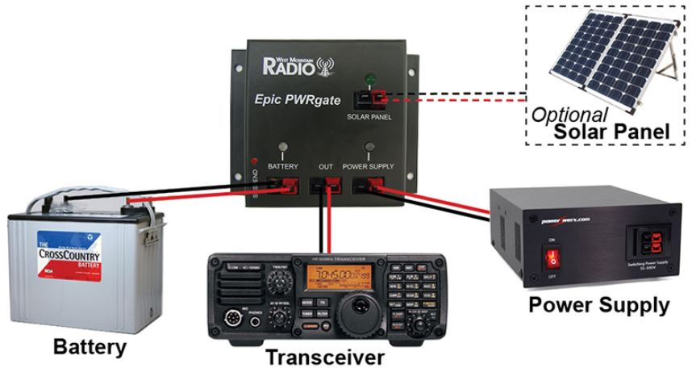
Battery, Component, Box and Tool Considerations
Battery Considerations
Sealed Lead Acid vs Lithium Iron Phosphate vs Lithium Iron Ferrite
Deep Cycle and not cranking power (MCA)
Size – Physical and Amp Hours
Component Considerations
Automatic Switching Devices, Inverter, Charger and Alarms
Switches and Connections
Which transceiver(s) to use
Box Consideration
Material
Rack mounts
Access to equipment
Tool Considerations
Crimpers and tools to carry
Antenna Tuner
Spare Parts

Slide 11
Case Study - Considerations
$
Very limited – use what I have
What frequencies do you want to cover
VHF now, HF when I get a small rig
Include ability to send data?
Want to be able to send email / data too
How long may you have to transmit without AC power?
Several Days
How many other devices need connectivity and how many amps to they draw?
A bunch
What resources are available to recharge?
Very limited sun, but . ..
What is the operating environment?
Could be harsh

Slide 12
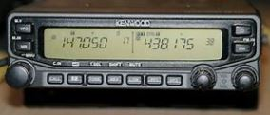
Case Study Transceiver Comments (Personal Opinion)
One Transceiver for all
Didn’t have one for HF and VHF/UHF – buying one would take money from the box
Thought about a Yaesu FT-857D ($850)
If it fails, nothing
Jack of all trades and master of none
Left
Voice
Right
HT Roam
Data
Multiple Transceivers
VHF / UHF Cross Band – I have a Kenwood V71 ($350)
HF - wish for a Yaesu FT-450D ($700) – can add it later

Slide 13
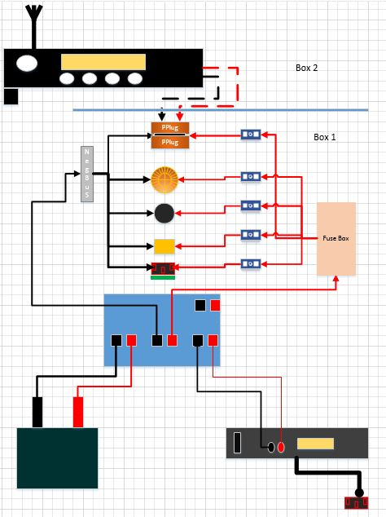
Case Study – Overall Diagram

Slide 14
Case Study – Overall Diagram
Radio Box
Transceiver
Mic
Power Connection
Antenna Connection
Signalink
VHF
HF
Battery
Power Supply
Power Gate
Switched Panel
Inverted Outlet
Power Box
To AC

Slide 15
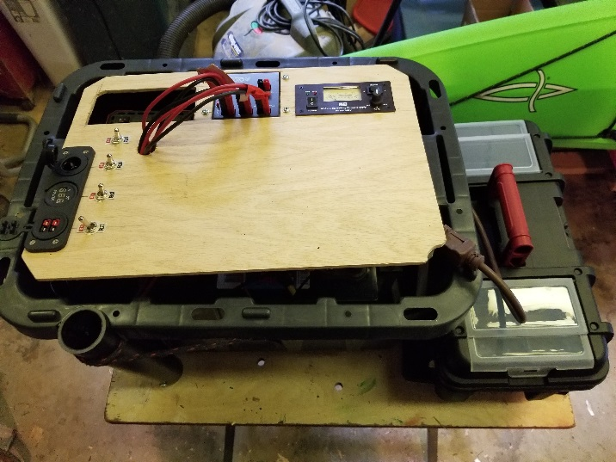
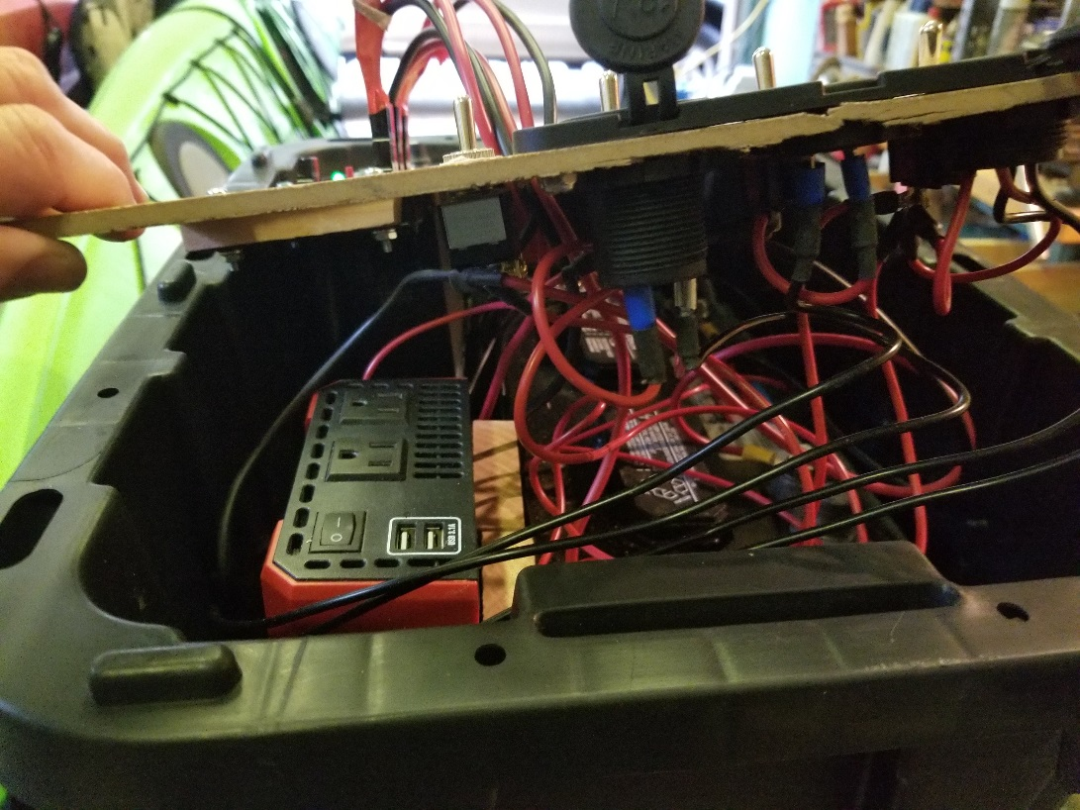
Case Study – Issues
Too much money
No HF
Redundant USB Charging Ports
Heavy, Bulky & Hard to Carry
Multiple Boxes
Became Concerned About Heat
One 14 gauge to two radios ☹
Couldn’t close the Lid!

Slide 16
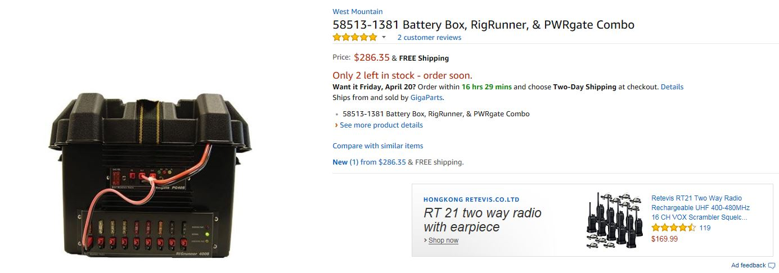
Case Study – Other Ideas

Slide 17
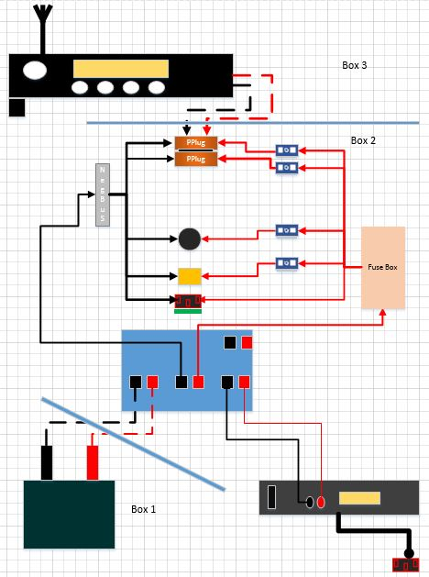
Case Study – Son of Go Box

Slide 18
Case Study – Son of Go Box
Radio Box
Transceiver
Mic
Power Connection
Antenna Connection
Signalink
VHF
HF
Battery
Power Supply
Power Gate
Switched Panel
Inverted Outlet
Switching Box
Battery Box
To AC

Slide 19
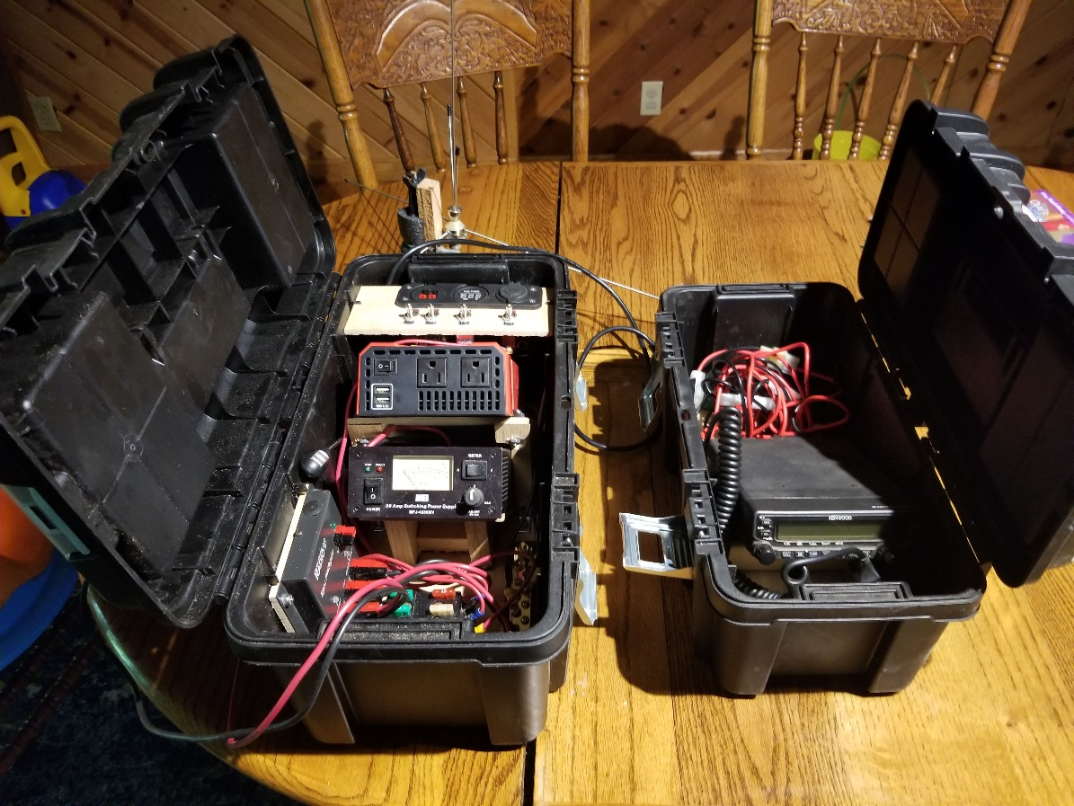
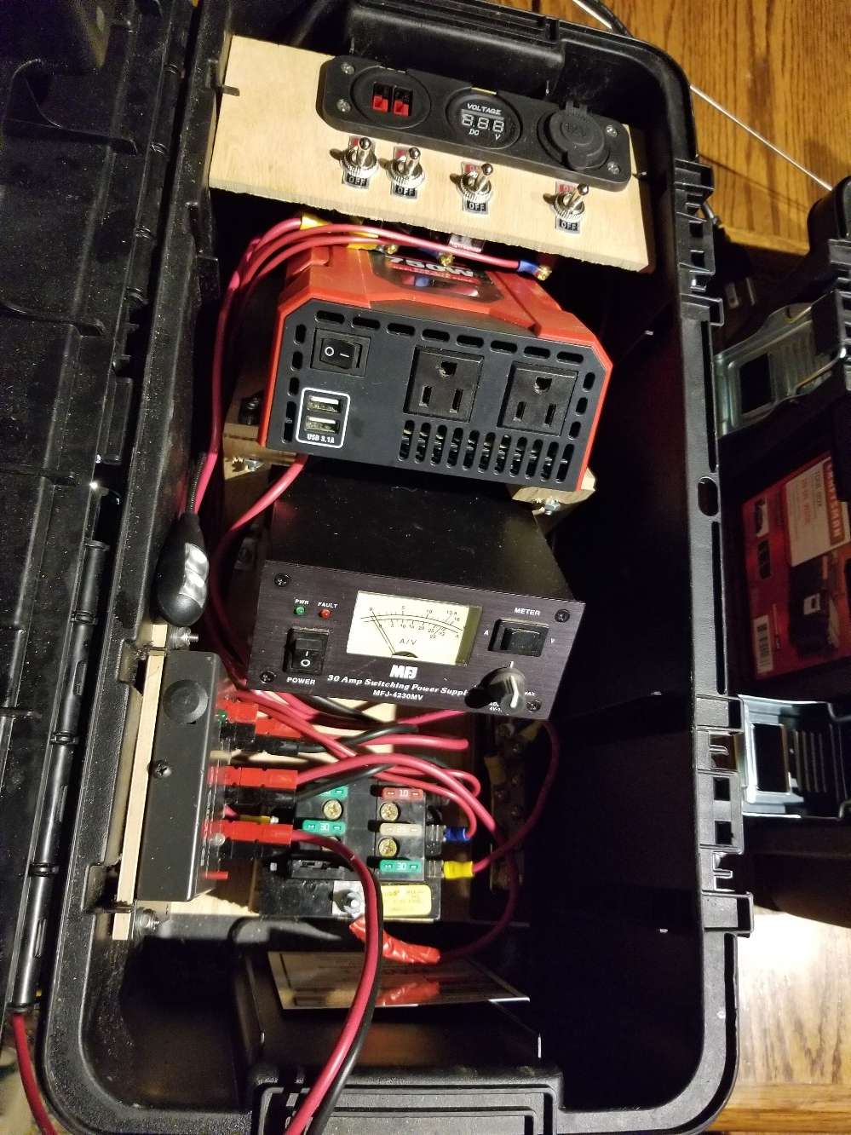
Case Study – Son of Go Box

Slide 20
Radio Go Box

